Slide 1
Do Now
What types of transportation are available to us in Nashville for our daily needs?
What is good and bad about each of these types of transportation?

Slide 2
Winners
Most Sustainable: Emits the LEAST amount of CO₂s.
Healthiest: Burns the MOST calories.
Most Affordable: Spend the LEAST amount of money.
Fastest: Spends the LEAST amount of time.

Slide 3
Reflection
Although the car is the fastest way to get around, what is its impact on the environment?
Why don’t students take more sustainable types of transportation such as walking, biking, or taking the bus to school more?
What do you believe would encourage students to take more sustainable types of transportation?

Slide 4
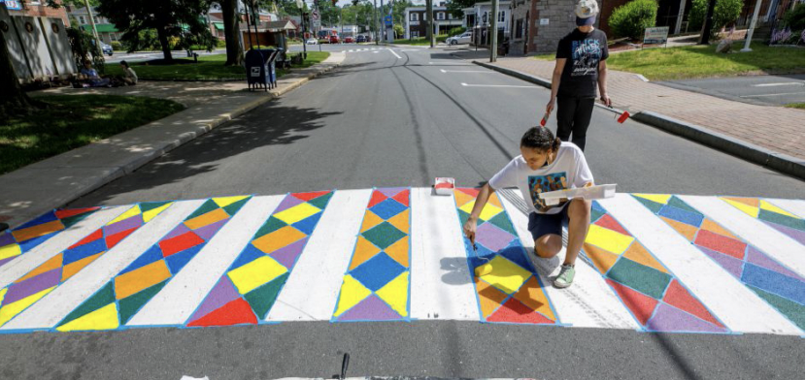
Sustainable Transportation Paint Challenge
Using only paint, design something that will make, walking, biking, or taking the bus a more pleasant experience.

