Slide 1
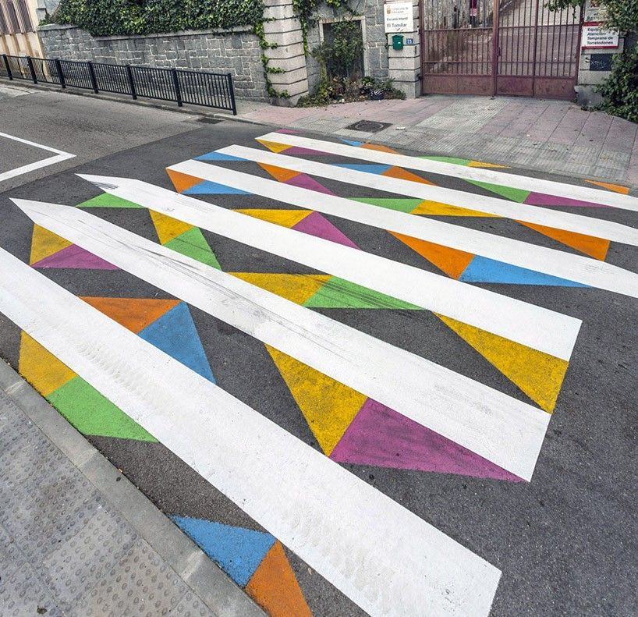
Example 1

Slide 2
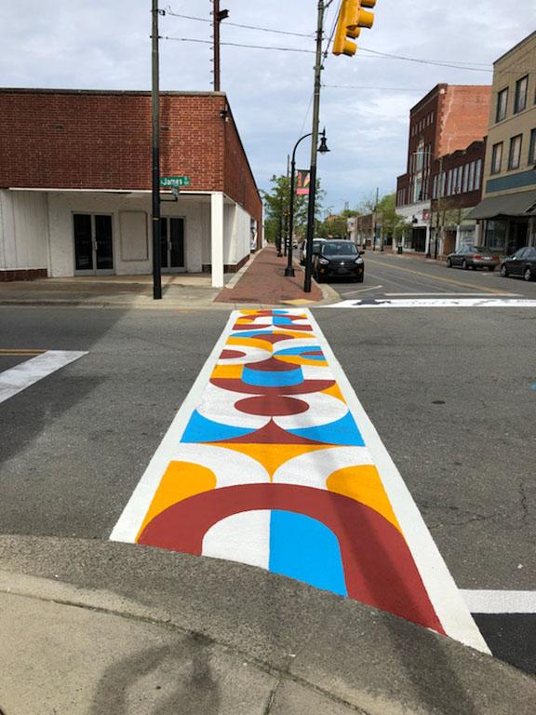
Example 2

Slide 3
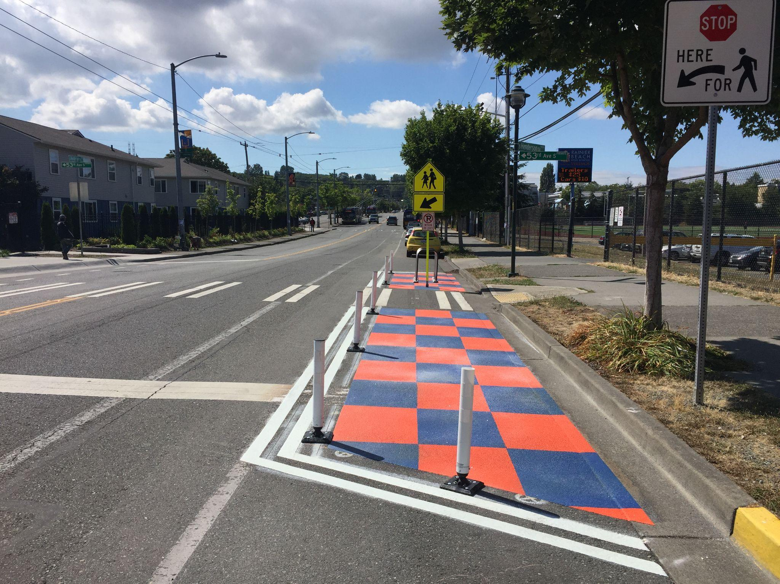
Example 3

Slide 4
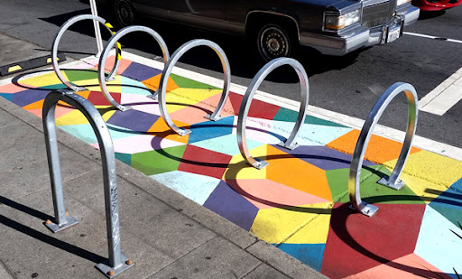
Example 4

Slide 5
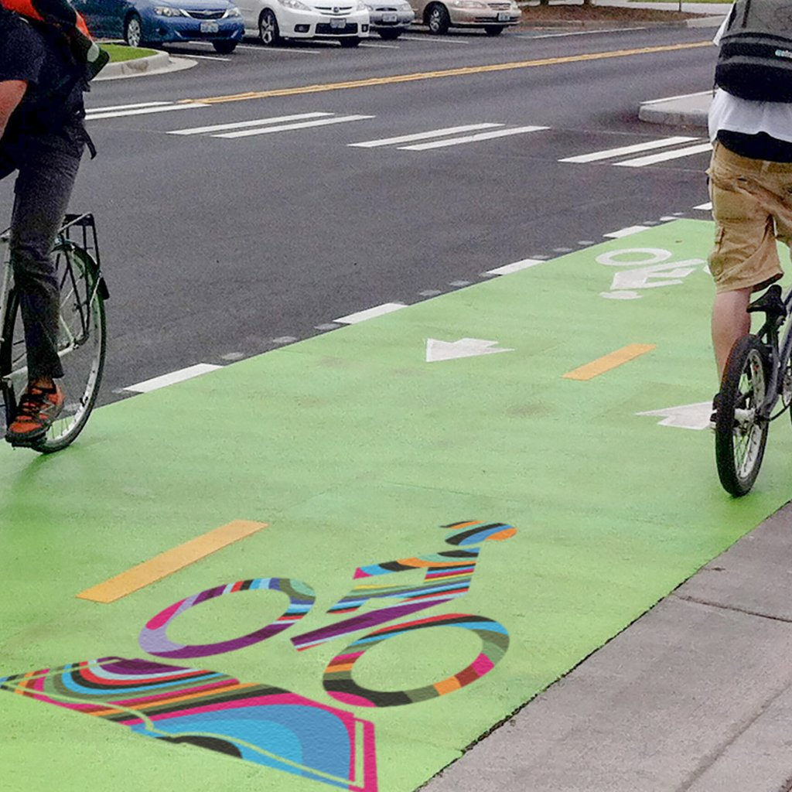
Example 5

Slide 6
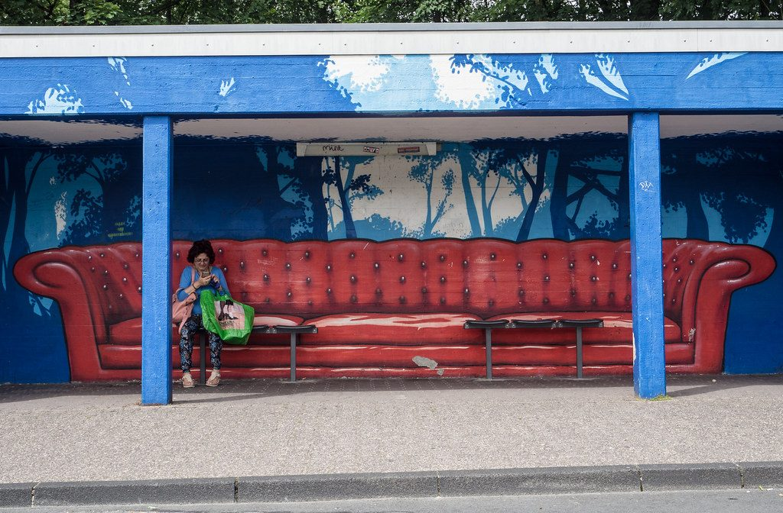
Example 6

Slide 7
Reflection
What are the advantages of adding artwork to sustainable transportation designs such as crosswalks and bike lanes?
Which examples do you think would be best for our school? Why?

